Slide 1
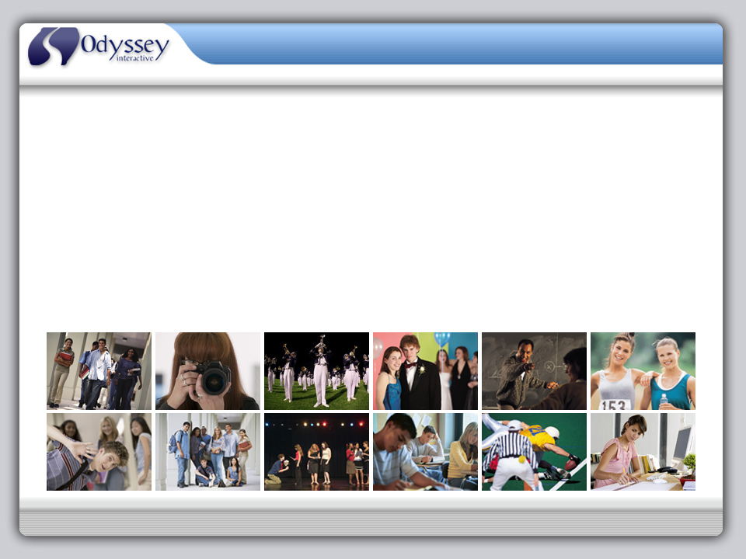
MyYearbookBuilder.com
Odyssey Interactive eYearbooks
Electronic Yearbook Production and Publication
Corporate Capabilities Presentation; Saturday, August 30, 2008
This presentation will run automatically.
To self-navigate, use the controls in lower left corner.
Presentation by: J. Gregory Durdock, President & CEO

Slide 2
eYearbooks
“Memory is a way of holding onto the things you love, the things you are, the things you never want to lose.”
~From the television show The Wonder Years
Odyssey Interactive digitally archives audio, video and photographs into an artistic, state-of-the-art eYearbook, so that your priceless memories will be preserved forever and also provide for countless hours of viewing pleasure.

Slide 3
eYearbooks
Welcome & Today’s Agenda
Welcome to Odyssey Interactive presentation, “eYearbook Production and Publication”.
This presentation is intended to provide you with an introduction to the MyYearbookBuilder.com system.
Learning Objectives:
Understand the benefits of electronic yearbook publication
Understand the features of an Odyssey Interactive eYearbook
Understand the capabilities of MyYearbookBuilder.com

Slide 4
eYearbooks
Company Profile
Odyssey Interactive, L.L.C. is a frontier, multimedia production company specializing in the development of custom digital solutions for archiving audio, video and photographs into an interactive electronic yearbook.
We possess a state-of-the-art digital production studio and an experienced staff of multimedia developers, whom provide our clients with account services throughout the entire creative development and production process.
Our client-focus, proven methodologies and detailed project management ensure that all of our projects will be completed on-time, within your budget and to specification.

Slide 5





eYearbooks
Introduction to MyYearbookBuilder.com
MyYearbookBuilder.com is a digital publishing system that integrates all facets of the yearbook creative development and production process.
It’s a powerful tool that provides a centralized point of entry for yearbook content collection, organization and management, which includes photographs, audio, video and written text.
The end result is a unique yearbook delivered on CD or DVD that contains artistic design, sophisticated technology and rich, interactive experiences.

Slide 6


eYearbooks
Why MyYearbookBuilder.com?
All parts of the traditional yearbook have been preserved in our system including eSignatures, and students can also sell advertisements in the form of eYearbook banner ads.
So, the difference is simple…we provide MORE for LESS!!!
More color
More pages
More expression
More personalization
More profit from fundraising
More days for collecting content

Slide 7
eYearbooks
Benefits of Electronic Yearbooks:
Digital
  eYearbooks may contain hundreds or even thousands of pages, with virtually unlimited color photographs, audio, video and personal profile information.
Self-expression & Personalization
  eYearbooks come to life as the entire school becomes involved in the production process, contributing memories, emotion and personality.
Cost Savings
  eYearbooks are about 35% less expensive to produce than comparable paper yearbooks, which means more profits for fundraisers.
Yearbook Turnaround
  eYearbooks can be delivered within 14 to 21 business days. This means that schools can keep their yearbooks running longer and also be including more memories from the ends of school years like spring athletics and prom.
Yearbook Replacement
  Because we maintain a permanent archive, obtaining a replacement or additional copies, at any time, is quick and easy.

Slide 8

eYearbooks
Key Features of MyYearbookBuilder.com:
An intuitive, unique web-interface for material collection and organization.
No software to install – it’s completely online.
No HTML or advanced programming knowledge required.
A Creative Wizard to guide users through the portrait development process.
An Upload Wizard to assist with adding photos, videos and audio files.
Real-time yearbook preview.
A dedicated, personable support staff.

Slide 9
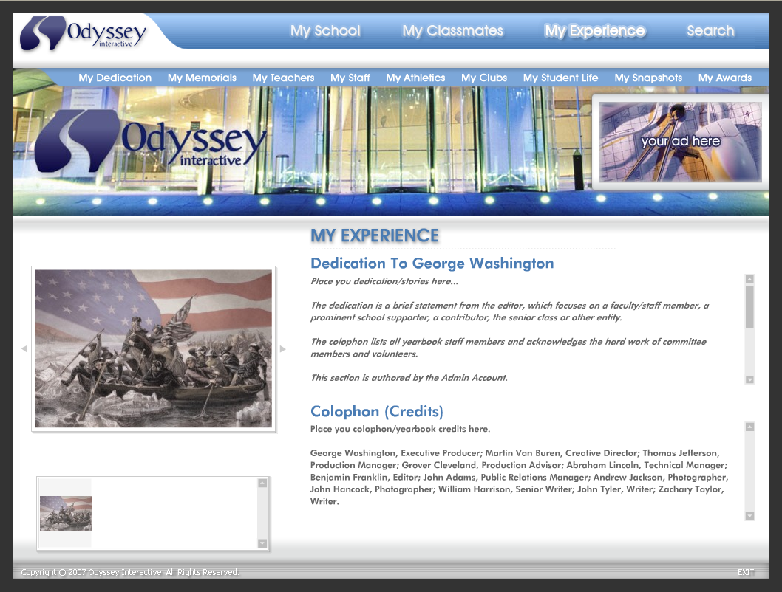
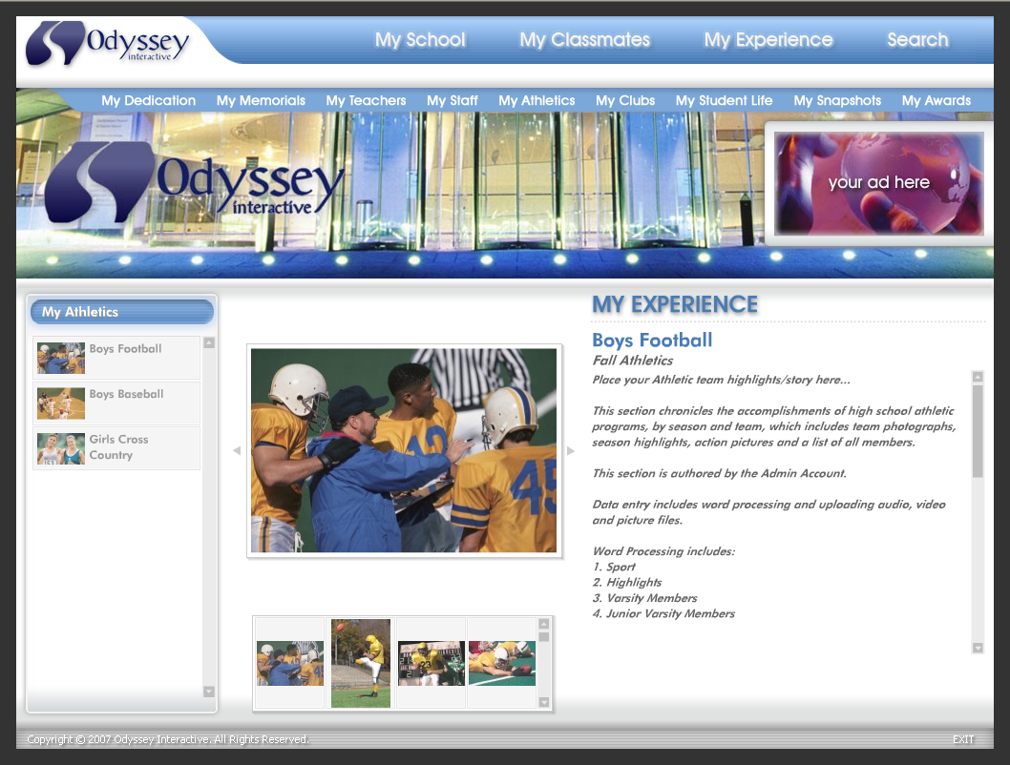
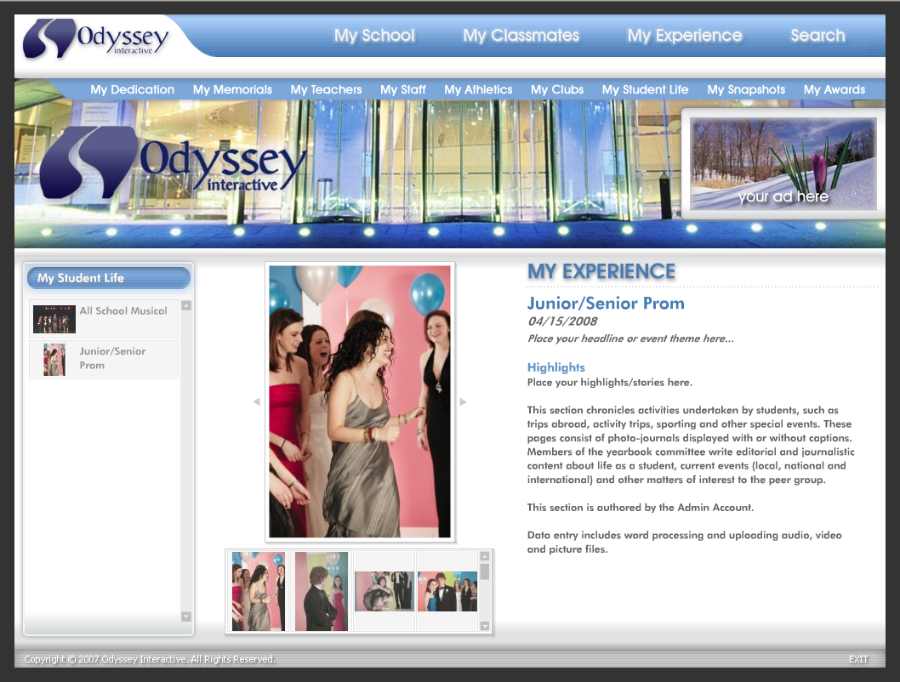
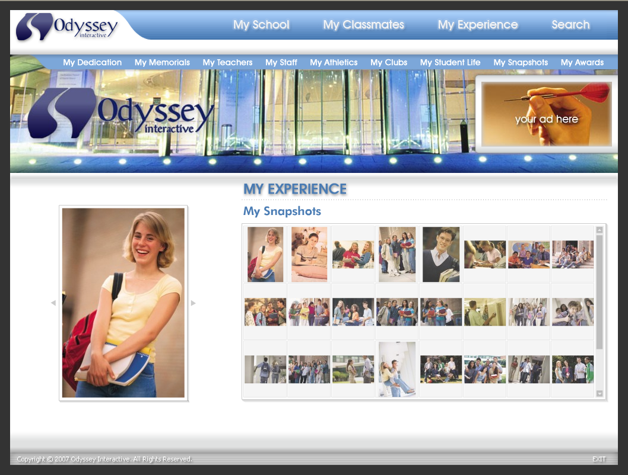
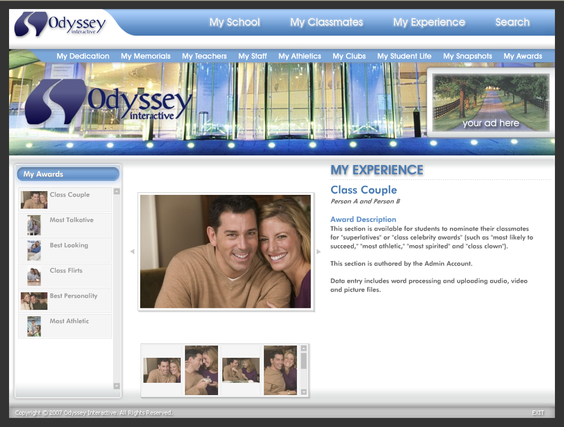
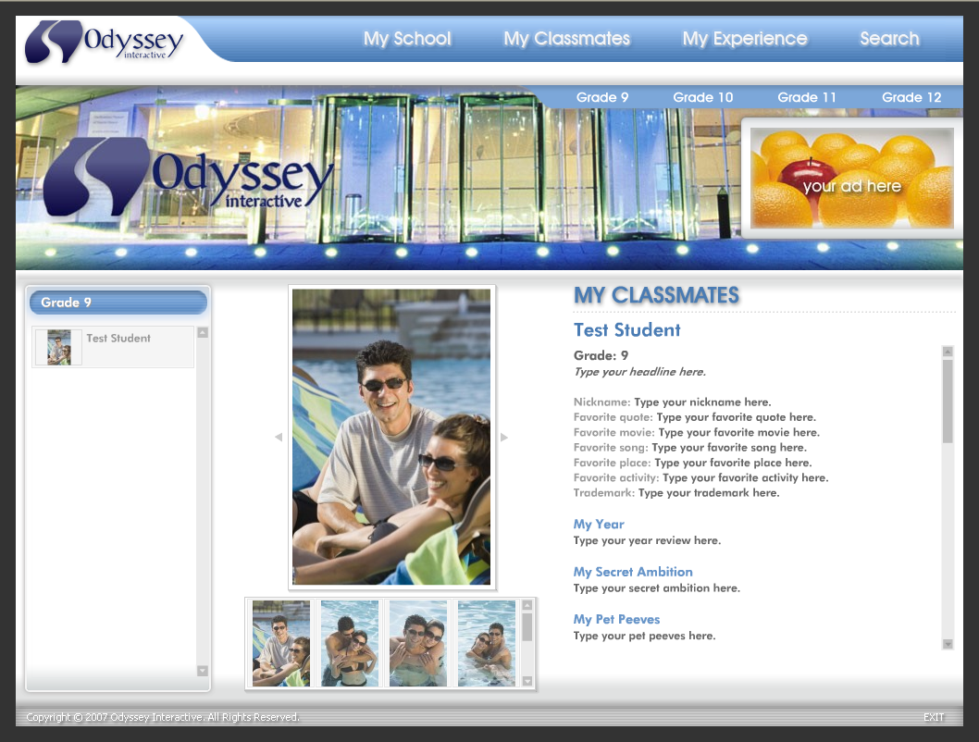
eYearbooks
eYearbook Sections:
Dedication(s)
Memorial(s)
Student Portraits
Faculty/Staff Portraits
Athletics
Clubs
Student Life
Awards
Snapshots
Advertisements
Athletics
Student Life
Snapshots
Dedication
Awards
Students

Slide 10
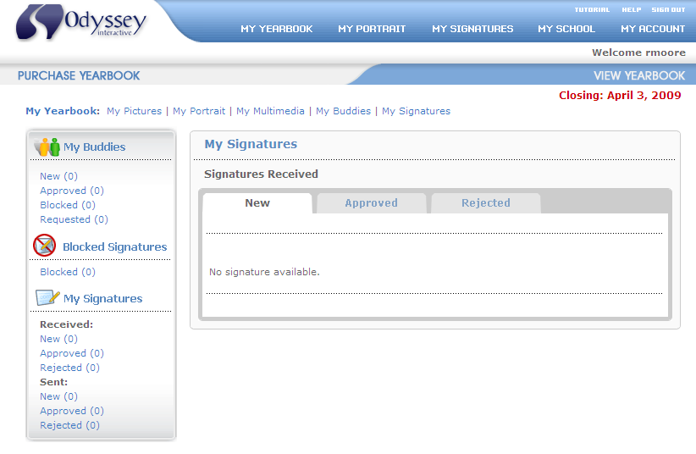
eYearbooks
Interactive Features:
eSignatures
Allow students to write messages to fellow students.
“Buddies”
Intra-yearbook student network.
Connect one student portrait to another.
eDictionary
Built-in dictionary that prevents the posting of inappropriate or offensive material.

Slide 11
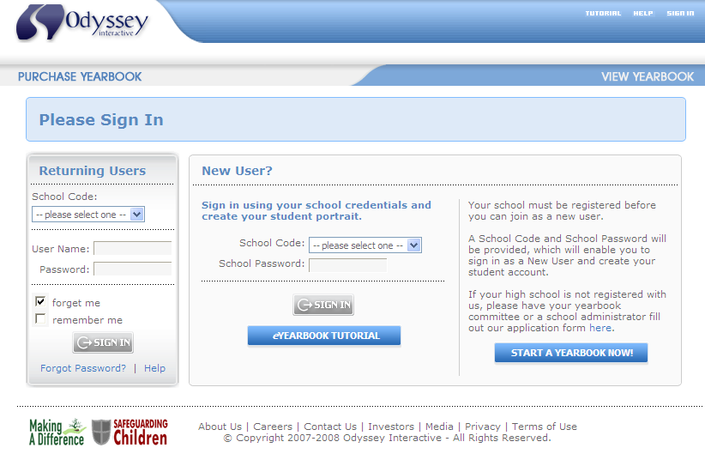
eYearbooks
Account Access
All eYearbooks require a “School Code”, “User Names” and “Passwords” for account access.
Each eYearbook contains two types of account access:
  Student account access
  Administrator account access
Privileges within the eYearbook database are restricted and solely determined by local account access.

Slide 12
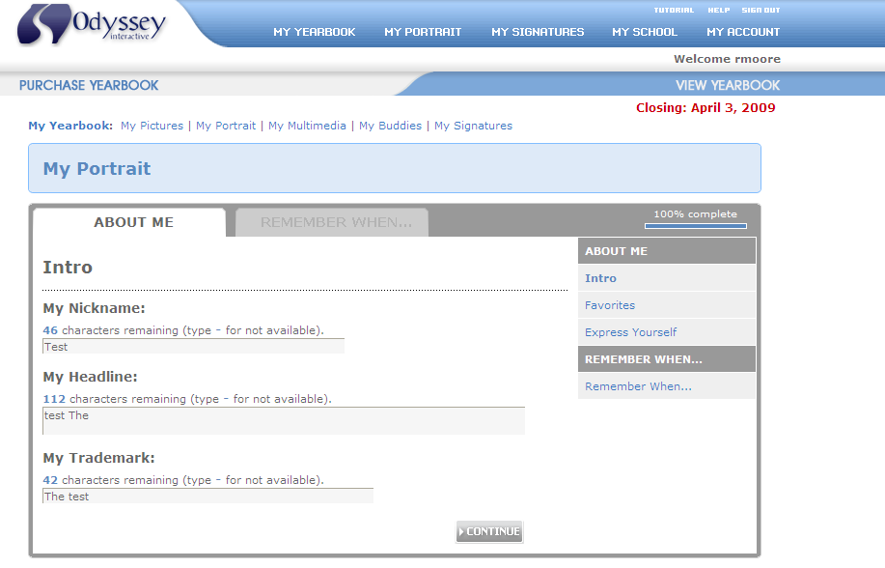
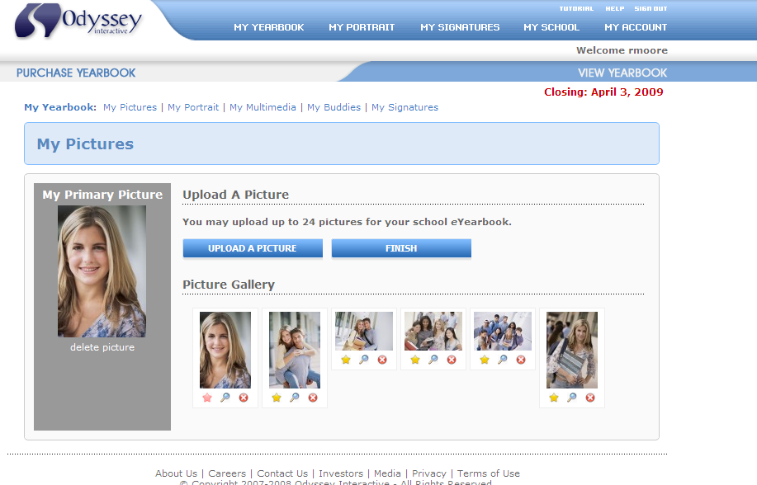
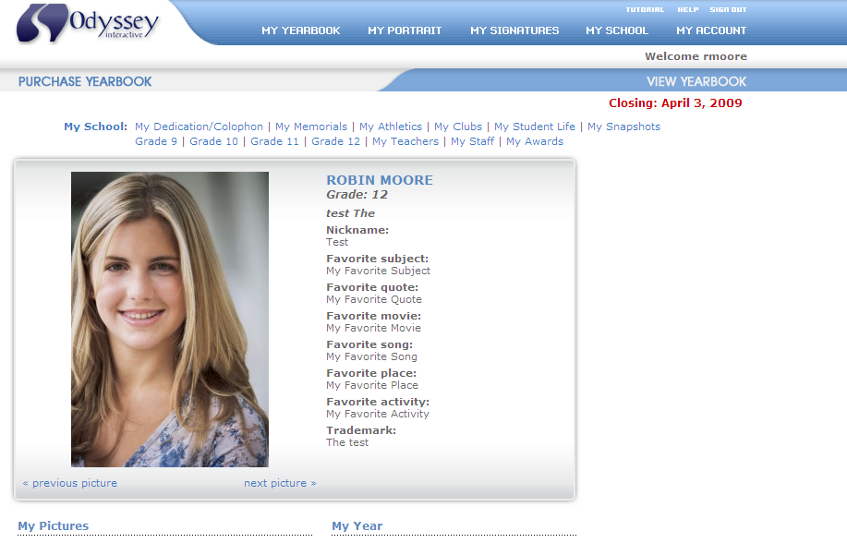
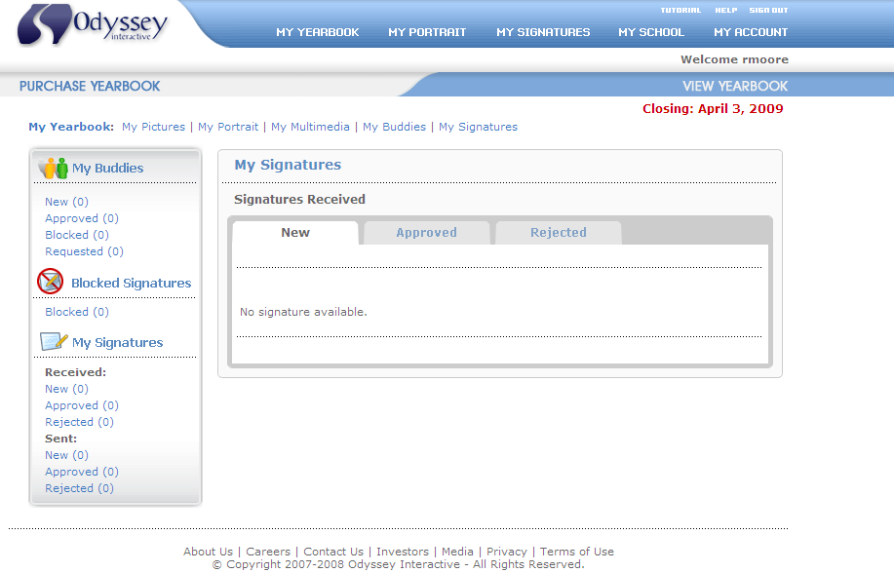
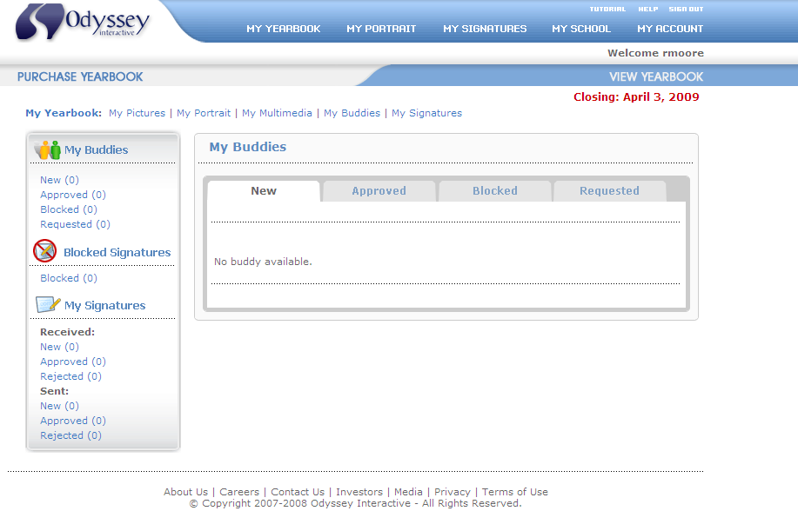
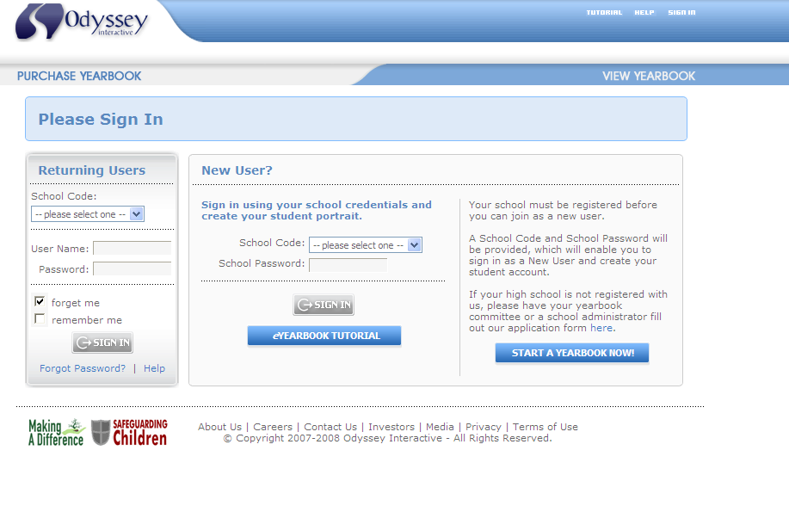
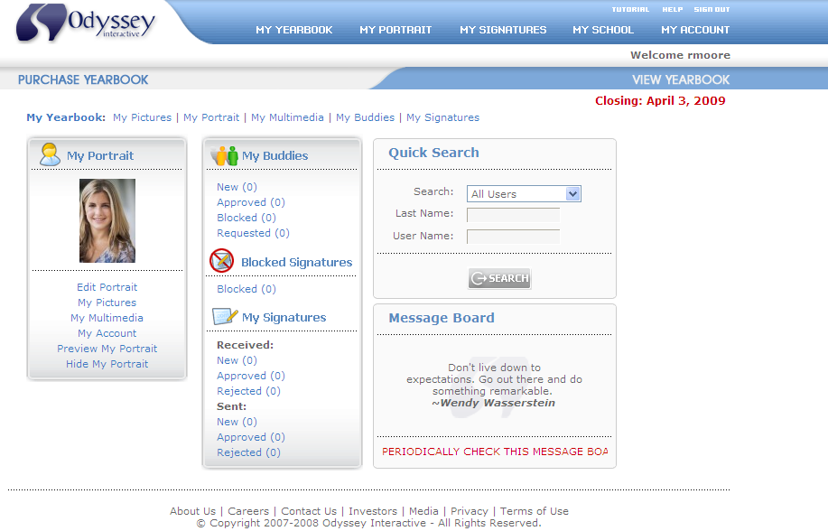
eYearbooks
Student Accounts
Required to build a student portrait and is opened via a registered email address.
Hosts each students profile, audio, video and photographs.

Slide 13
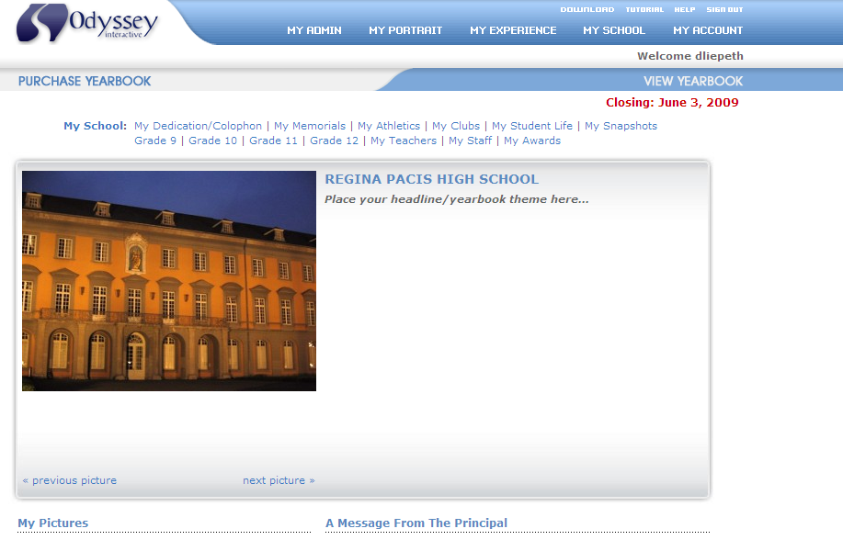
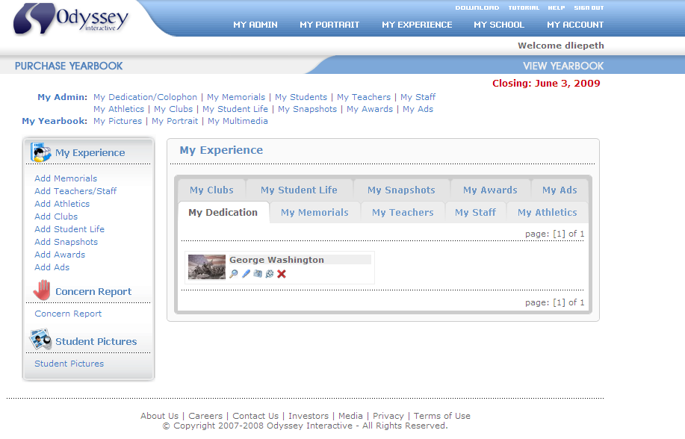
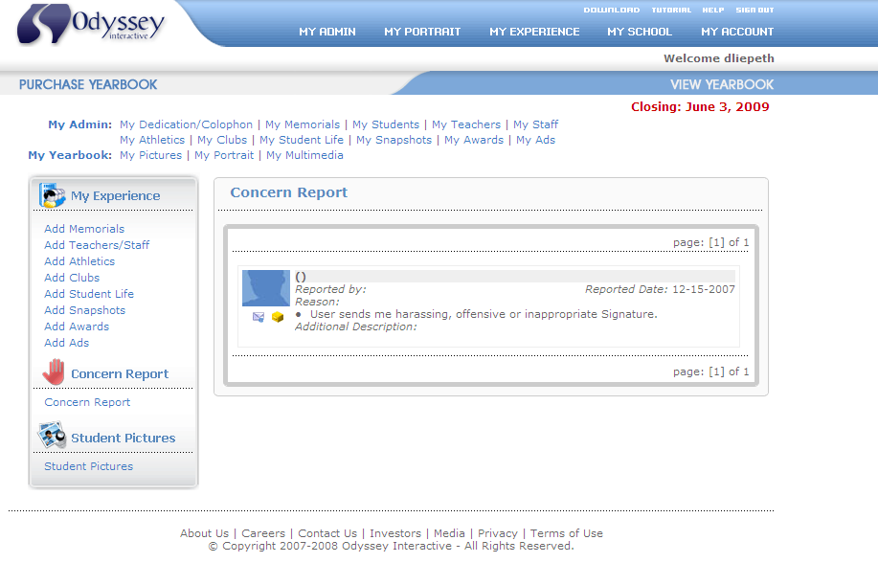
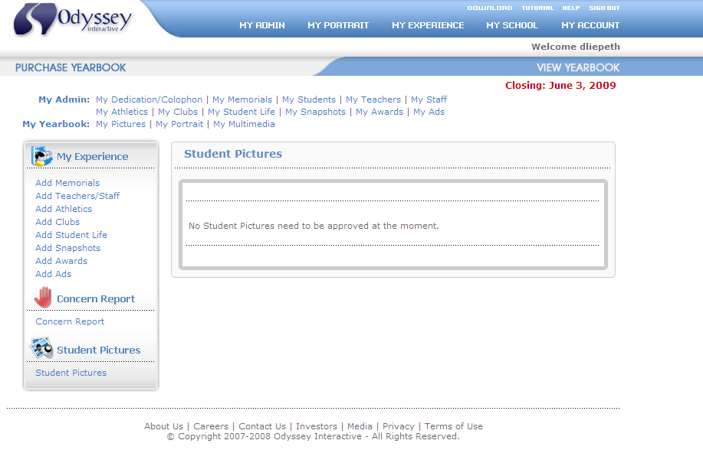
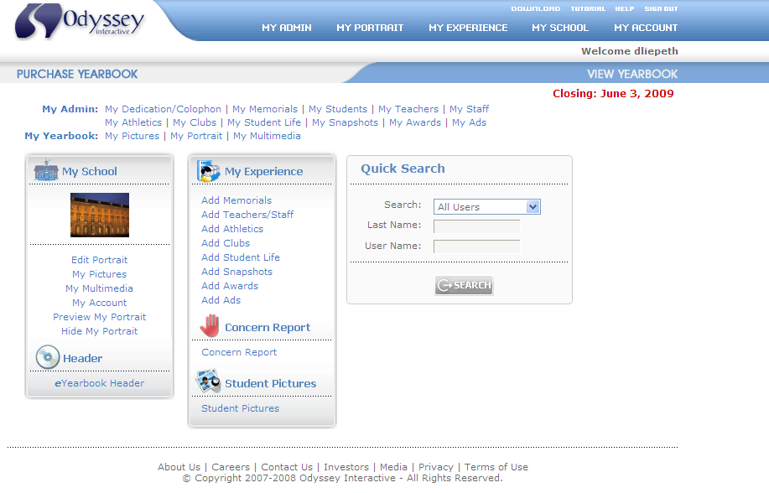
eYearbooks
Administrator Account
Required to incorporate non-student portrait information like athletics or special events.
Capable of reviewing/editing student profile information.
Responsible for approving all photographs posted to the site.
Manages properties & timelines for yearbook production.

Slide 14

eYearbooks
Safety and Security
The safety and security of our users are a top priority; we closely monitor student website activity.
MyYearbookBuilder.com is a restricted and closed access community. We take appropriate physical, electronic and procedural security measures to protect personal information from unauthorized access and/or disclosure.
Any and all access violations and/or violations of terms of use agreement will be immediately reported to the proper authorities and may be prosecuted to the fullest extent that the law permits.
“Report A Concern”
A vehicle for students to anonymously report material that is inappropriate, offensive or harassing in nature.

Slide 15

eYearbooks
Cost savings
Digital
Faster turnaround
Faster turnaround
Digital
Personalization
Cost savings
Self-expression
QUESTIONS???
Faster turnaround
Self-expression
Digital
Personalization
Self-expression
Personalization
Cost savings

Slide 16

eYearbooks
Let the Odyssey begin…
End of Presentation
Thank you!
Contact:
J. Gregory Durdock
President & CEO
Odyssey Interactive, L.L.C.
gdurdock@odysseyinteractive.com
www.MyYearbookBuilder.com
REQUEST INFORMATION
START A YEARBOOK
VIEW A YEARBOK

Slide 17
eYearbooks

